Slide 1
4 Keys To Better Concepts The Right Brain Studio Guide To Developing The Best New Product & Positioning Concepts

Slide 2
The 4 Keys

Slide 3
You Gotta Have Heart
Any product or service hoping to be successful has to provide some tangible benefit. Smoke and mirrors might get someone to try it once, but if the experience doesn’t deliver, that’s that.
But making a great product is the cost of entry. If you’re a restaurant, you better have great food. If you make deodorant, it better smell good and work effectively.
Technology may be proprietary, but it might not be for long. Regardless, a timeless, emotional benefit will always trump functionality.
We all know about the “badge value” of brands and how they need to strike a responsive chord on a deep emotional level in order to stand apart from competition. Yet marketers often think that the magic doesn’t happen until the package is designed or the ad is made. Not true!
Great execution can and should bring the magic to life, but the magic has to start with the idea, the concept, the brand promise.

Slide 4
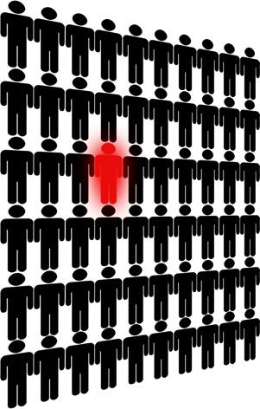
Define Your Difference
Tell people why your unique point of difference and avoid “Your Product Here” concepts at all costs.
It’s amazing how many generic concepts we run across. While it may be painfully obvious that you have to give people a specific, proprietary reason to buy your product, this often gets lost at the concept stage.
Consider the following two positions by a prominent, award-winning advertising agency for a food product:
“Big Flavor” - If you’re looking for a (product category) that’s full of savory, satisfying flavor, reach for new (product).”
“Perfectly Portable” - It seems like more and more meals are being eaten outside the home. That’s why (product) is sure to come in handy.
If you can substitute your product name with any other brand in your category – like you can in these examples - you have a problem.

Slide 5
Focus
Concept loading, or feature overload, is a sure way to kill concepts and cause confusion.
Our long time design partner, Shikatani Lacroix Design, stresses the importance of what they call “The Blink Factor” when they develop packaging. The goal is to emotionally connect consumers to your brand in “the blink of the eye” when they see your package or logo. Often, this is all the time you’ll ever get.
Their system of design optimization also works with the printed word. The goal is to maximize “enhancers,” minimize “passengers” and eliminate “detractors.”

Slide 6
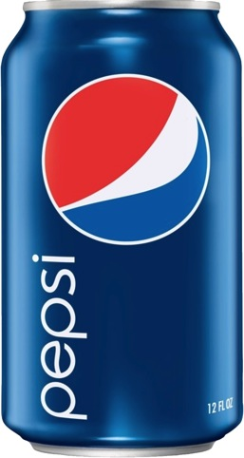
Focus (Continued)
“Enhancers” are packaging elements that bring the core emotional benefit to life. In the case of a written concept, this is a simple, single-minded, emotionally driven benefit.
“Passengers” are necessary on packaging, but they are elements that are “only along for the ride.” A passenger might be “12 fluid ounces” or “non-toxic.” These can almost always be eliminated entirely when testing concepts by including a “base concept” before presenting alternative positioning concepts. The base concept can lay out functional features and other product details. They they do not have to be repeated in each positioning concept.
“Detractors” are elements that take away from the core emotional benefit. For example, if the concept focused on a benefit of “fun” or “sociability,” then attempting to add credibility by saying “Great Taste” or longevity (“Since 1876”) would detract from the core essence of the concept

Slide 7
Speak Your Target’s Language
It stands to reason that whatever language your consumers speak, you would want to communicate with them in that language. But all too often, companies are speaking Greek to customers who speak English. Their message isn’t just lost in translation. It’s just lost.
This happens more often than not with technology based products, but the danger exists for packaged goods and other products as well.
Consumers care about things like the feeling they get from driving fast or using a sexy new kind of cell phone that provides easy access to their music, emails and the Internet. Internal combustion and arcane programming codes are the last things on their minds.
Style and substance are both important here. Companies live with their internal culture and rhetoric which are often at odds with how consumers think and speak. And while companies are rightfully proud of the technological breakthroughs that make their products work so well, consumers could usually care less. At best, these are support points, not a product’s reason for being.

Slide 8
Definitions and Guidelines

Slide 9
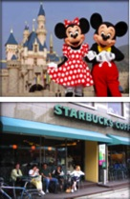
“Concept” Definition
Marketing “concepts” are the tools we use to arrive at a compelling brand positioning for new or existing products
Ideally, each concept should express a clear, unique, emotionally driven reason why the target should buy your product
What Do You Make?
Here’s a great exercise to get you started. Ask yourself, “What do you make?”
The answer cannot be functional or rational. The idea is to ladder up to an emotional benefit or the feeling provided by the product experience
= Magic not Theme Parks
= Community not Coffee

Slide 10
“Concept” Definition
Concepts are works in progress and may be expressed in different formats, with or without graphics.
A wide range of single-minded concepts should be developed to put “stakes in the ground” for internal discussion, qualitative and quantitative research
Concepts should constantly evolve and be revised accordingly as they are exposed to internal stakeholders and consumers

Slide 11
Concept Format
Concepts should be short and single-minded.
A headline that expresses the main benefit in an emotional context and a few sentences of copy at most.
Key thoughts:
We want to know what we are testing.
Long concepts, packed with features, usually serve to confuse rather than clarify.
We want reactions to substance, not style.

Slide 12
Concept Example
For an herbal beverage with calming qualities:
The Natural Way to Calm
Relax in sync with nature and your body’s natural rhythms.
Enjoy a natural calm with clarity and none of the depressive, mind-numbing side effects of alcohol or prescription drugs.
Switch to Calm
Switch to calm without switching off. Feel yourself moving to a better, calmer place, where mind and body are relaxed but alert and focused.
Here’s a natural transition from stressed to calm without the haze of drugs or alcohol, so you can de-stress but stay focused.

Slide 13
“Positioning” Definition
Brand positionings are define a single-minded reason why someone should buy your product
Positionings should be more detailed than working concepts, including, at the very least:
Target
Brand Position
Support
Brand Personality
Who are we selling to?
Why should they buy? Emotionally driven, proprietary, motivating and relevant
Tangible and emotional support points
How should the brand feel to the target?
Who are what would it be if it came to life?

Slide 14
Positioning Example
Brand Position:
Troy Adams Designs: The creators of Fusion Design, incorporating Asian, European and American design sensibilities to create home environments that express your personal style effortlessly.
Support
Troy’s roots in Hawaii, the essence of “fusion”
East meets west, Bringing the outdoors in and the indoors out, The epitome of “ease” and “effortlessness”
Flexibility and authority
Traditional or modern, European, Asian or American, we can draw on it all, TAD has the knowledge, creativity and good taste to make design work, no matter what the inspiration
Focus on the customer
TAD as expert, knowledgeable facilitator
Brand Personality:
Jackie Chan meets Giorgio Armani
“His name (is) a by-word for sleek, exquisite tailoring and taste.”
“Giorgio Armani likes to explain his thinking about style and design by reference to three golden rules; eliminate the superfluous, emphasize the comfortable and acknowledge the elegance of the uncomplicated.“
Creative
At ease
In control everywhere
Embraces his environment, adapts, makes it work to his advantage wherever he is, no matter what the situation

Slide 15
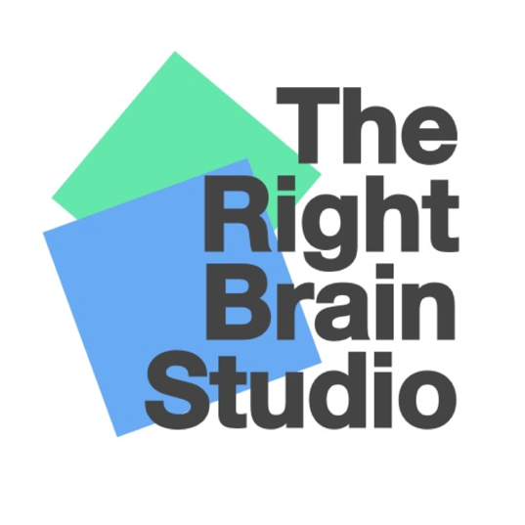
Contact
Jeff Hirsch
The Right Brain Studio
818-400-7922
jhirsch@therightbrainstudio.com
www.therightbrainstudio.com

